Slide 1



Diagnostic and therapeutic capabilities of the ceramic dressing CERDAK in infected non-healing wounds
Dr. Marián Piš
Dr. Ján Tomka PhD, MPH, MHA
Department of Vascular Surgery, NÚSCH, Bratislava, Slovakia
WSCTS
September 2nd-4th

Slide 2

The limitations of bacterial diagnostics in infected wounds
Standard methods Alternative methods
Sonication of the ceramic dressing CERDAK
Wound swab
Wound biopsy
Sensitivity
40-60% 70-90% 89-94%

Slide 3
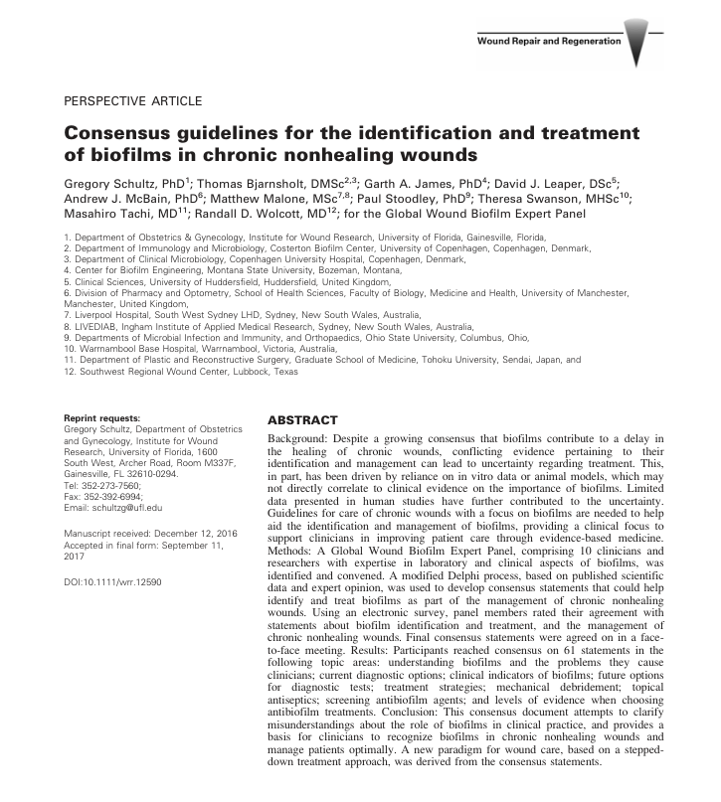
The issue of bacterial diagnostics in infected wounds
According to the international consensus from 2017, a biofilm is present in almost all non-healing wounds. In the presence of a biofilm, it is not recommended to perform a swab from the wound, as it is unproductive.
However, we usually treat wound infections based on the results of swabs, which we call targeted antibiotic therapy, but we often do not capture the true agent causing the infection!

Slide 4
What is sonication of the ceramic dressing CERDAK?
Sonication is a method that uses sound energy to disrupt particles.
Sonication of ceramic dressing CERDAK is an alternative non-invasive laboratory diagnostic method, where it is possible to release planktonic forms of bacteria from the surface of ceramic granules using ultrasound without damaging them, this allows to culture and identify the bacterias
By this method we can detect bacteria that are involved in biofilm formation or were not captured by swabs

Slide 5
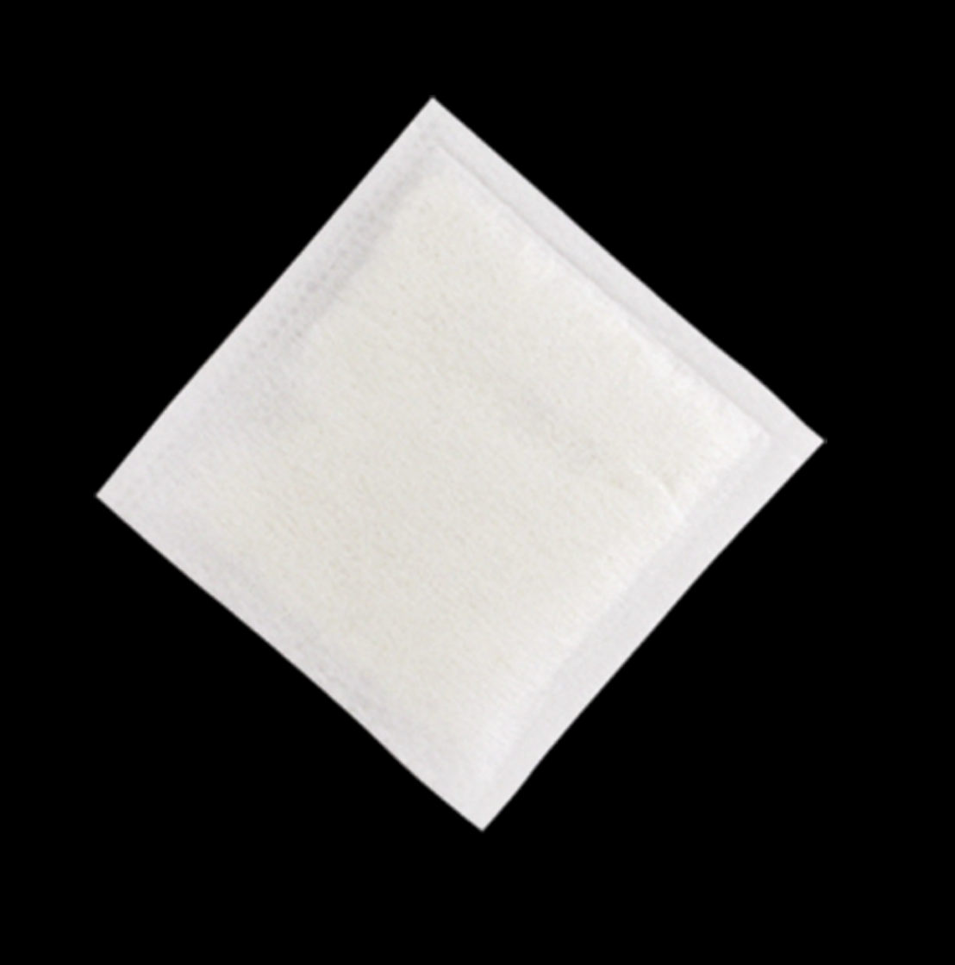
Why the ceramic wound dressing
CERDAK?
Inert ceramic dressing made of aluminum oxide (alumina) granules with a size of 0.2-1 mm
It belongs to non-medicated antimicrobial dressings
It contains micropores in its structure
It works on the principle of capillary succion
With the exudate, it also absorbs bacteria and endotoxins into the dressing
Bacteria are captured and accumulate in the micropores of the granules.
Cerdak Wound Dressing: SEM Images of Bacterial Sequistration - Biofilm Assessments
Sana Shah & Dr Jason Ashworth, Manchester Metropolitan University

Slide 6

Prooved disruption of the biofilm by the ceramic dressing CERDAK
Cerdak Wound Dressing: SEM Images of Bacterial Sequistration - Biofilm Assessments
Sana Shah & Dr Jason Ashworth, Manchester Metropolitan University

Slide 7
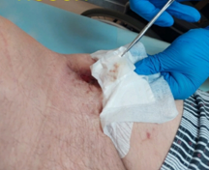
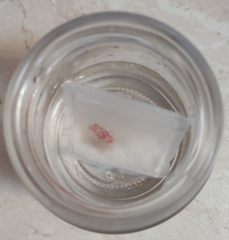
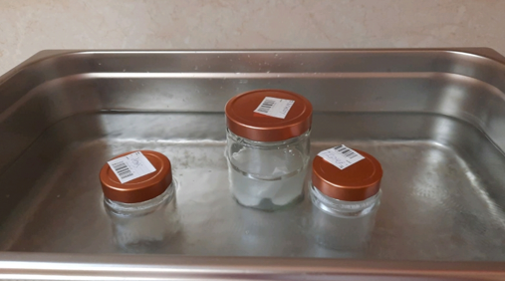
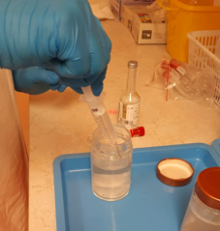
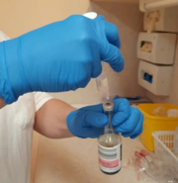
Our research on diagnostic and terapeutic capabilities of the ceramic dressing CERDAK
5/2023 -5/2024 (12 months)
34 wounds in 32 patients (5 wounds excluded)
55 sonications and 55 swabs
Prospective study
Based on a pilot study from the University of Graz, we tested the diagnostic and therapeutic abilities of ceramic dressing CERDAK

Slide 8
3 aims of the research
First aim of the research was to compare the detection rate of bacterial strains using the sonication method of ceramic dressing CERDAK and swabs, and to evaluate the diagnostic capabilities of the ceramic dressing overall
Second aim of the research was to implement targeted antibiotic therapy based on the results of sonication of the ceramic dressing and to assess its effectiveness
Third aim of the research was to analyze the size of wounds during 8 weeks of treatment with ceramic dressing CERDAK and to evaluate its therapeutic capabilities in the treatment of wound infections.

Slide 9
Wound characteristics
SSI after the revascularisation | 19
Venous leg ulcer | 5
Diabetic foot syndrome | 3
Chronic infection of vascular graft with fistulation | 2
Mixed arterio-venous leg ulcer | 2
Arterial leg ulcer | 1
Dehiscence after amputation | 1
Perigluteal ulceration | 1
Total 34

Slide 10
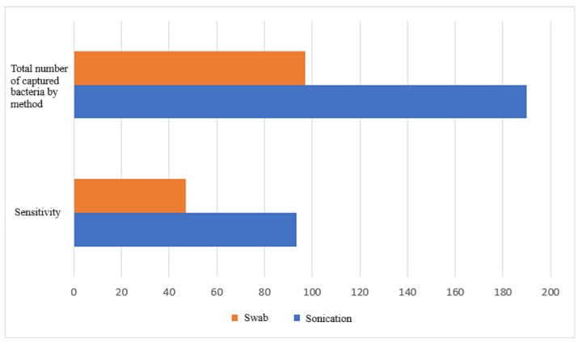
The number of captured bacteria and the sensitivity of individual methods
Total number of captured bacteria 287
Number of bacteria captured by sonication 190
Number of bacteria captured by swab 97
Sensitivity of sonication 93,6%
Sensitivity of swabs 48%

Slide 11
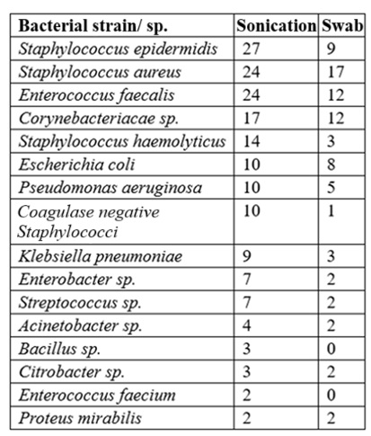
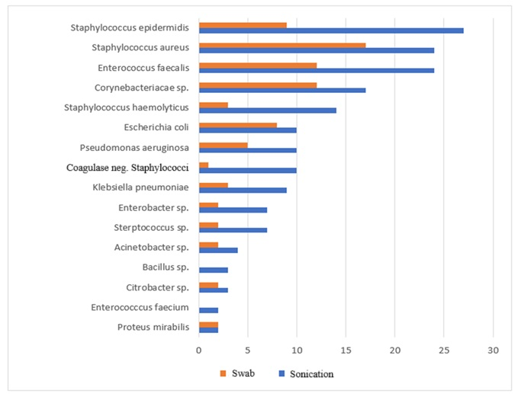
The most frequently captured bacteria by the method of sonication and swab

Slide 12
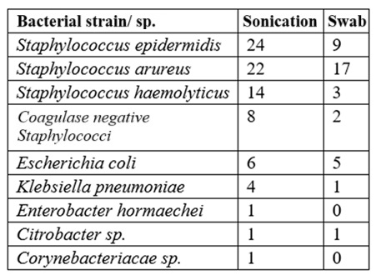
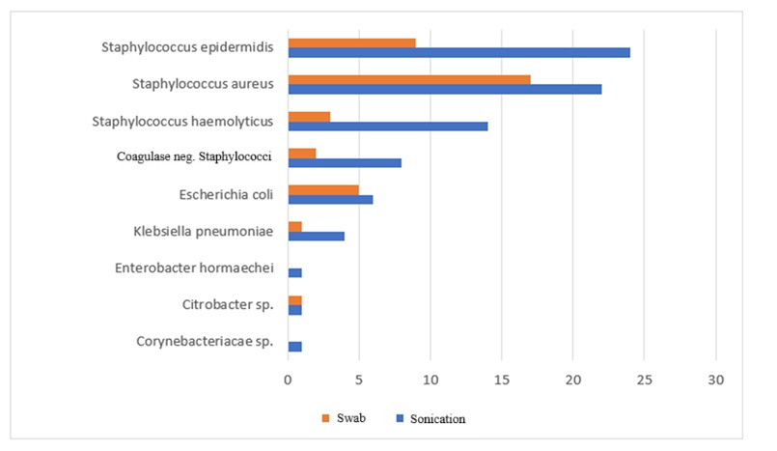
The most frequently captured resistant and multidrug-resistant forms of bacteria by the method of sonication and swab

Slide 13
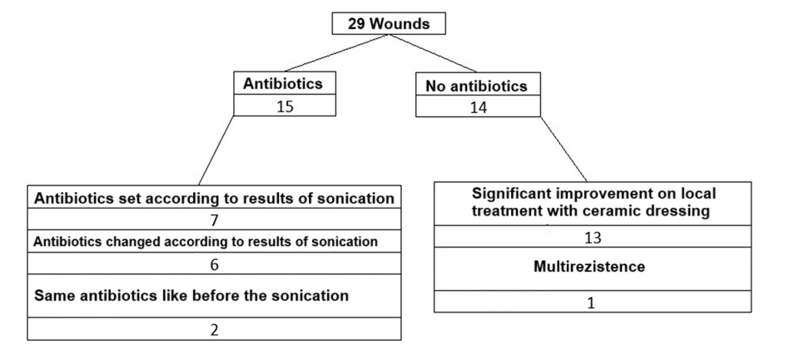
Antibiotic treatment according to the sonication of the ceramic dressing CERDAK
In 13 out of 15 cases, antibiotic treatment was adjusted or initiated based on the results of the sonication of the ceramic dressing

Slide 14
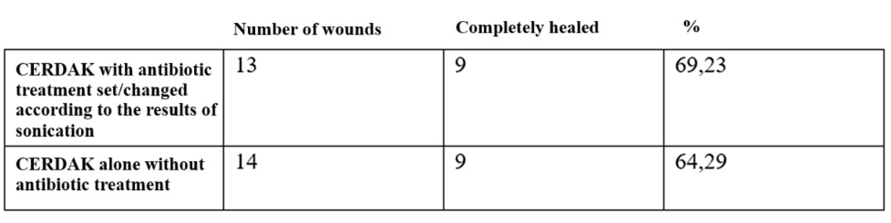
The success of treatment according to the sonication of the ceramic dressing CERDAK
In 13 cases, antibiotic treatment was adjusted or initiated based on the results of sonication of the ceramic dressing, 9 wounds healed completely during the monitored period, which represents 69.23%
In 14 cases, we relied solely on the local antimicrobial effect of the ceramic dressing, 9 wounds healed completely during the monitoring period, which represents 64.29%

Slide 15
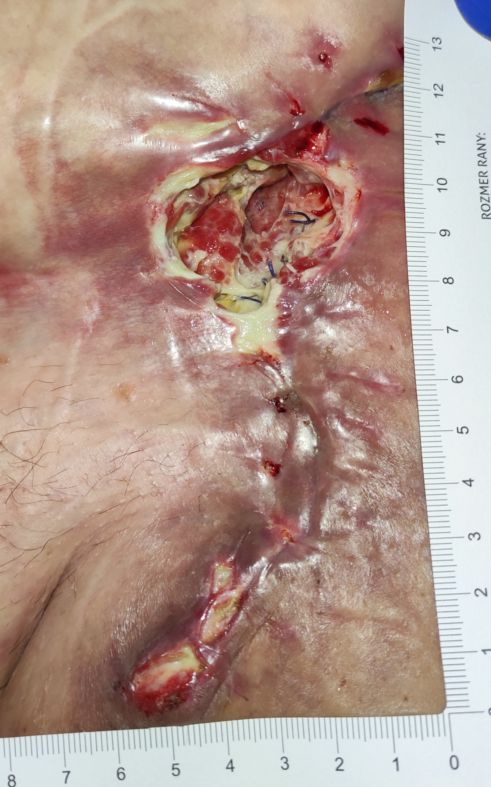
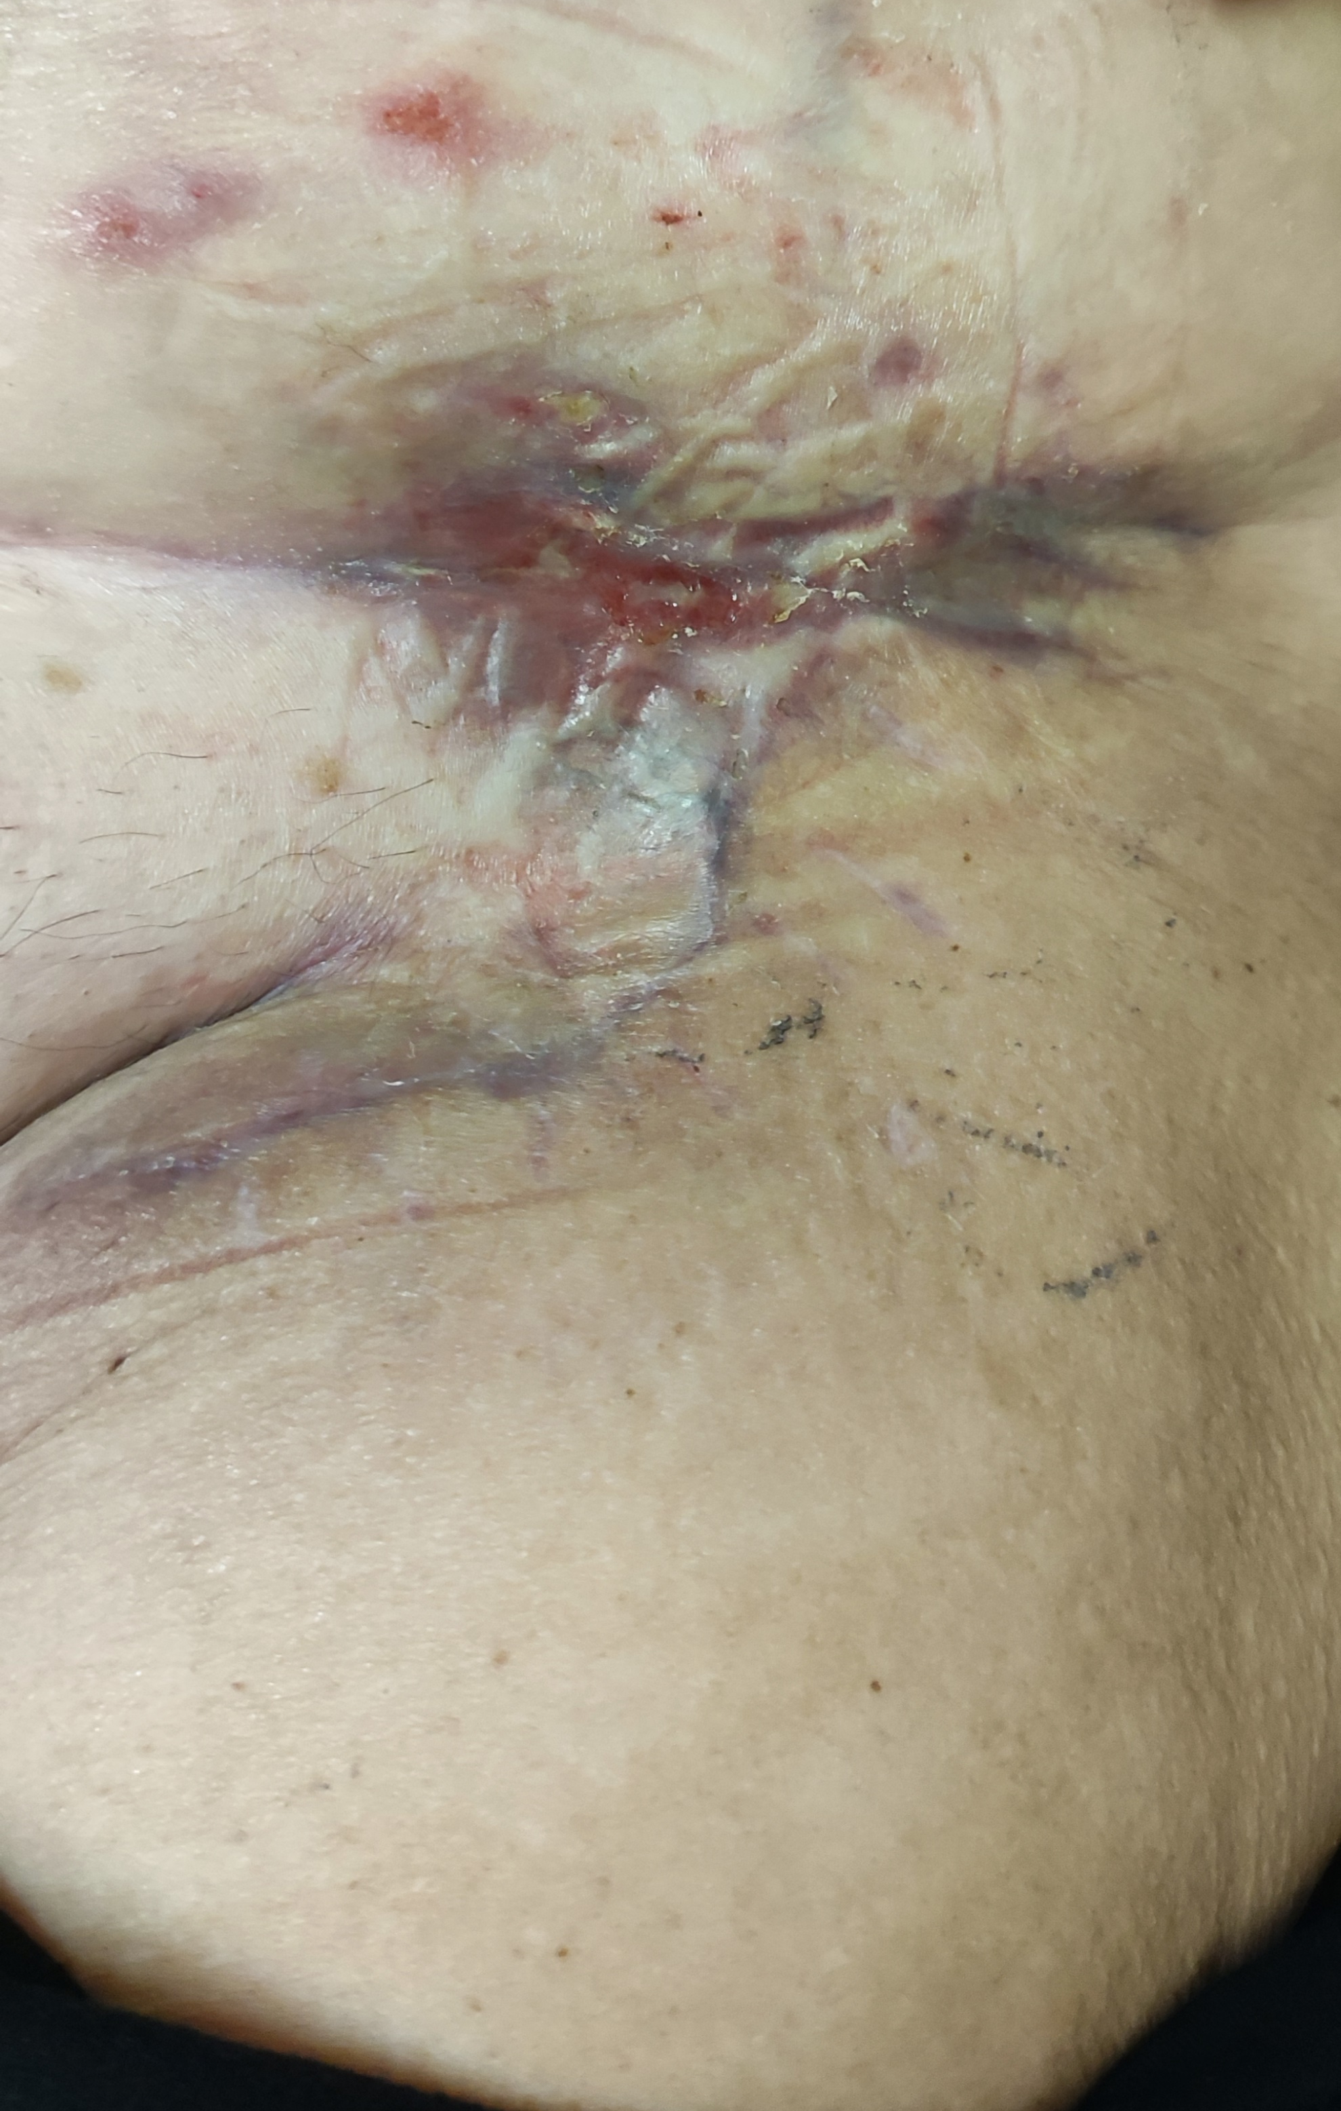
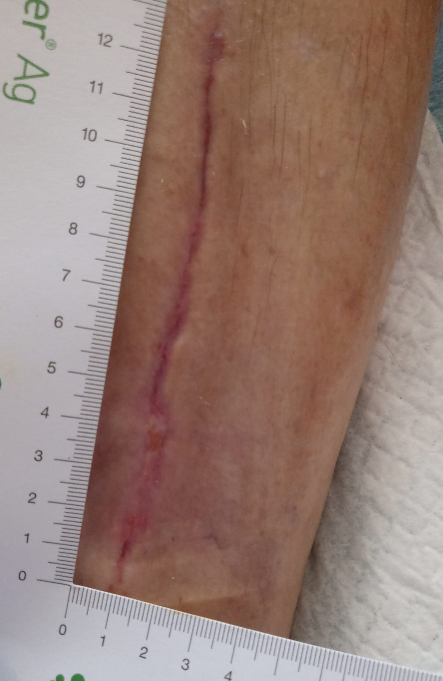
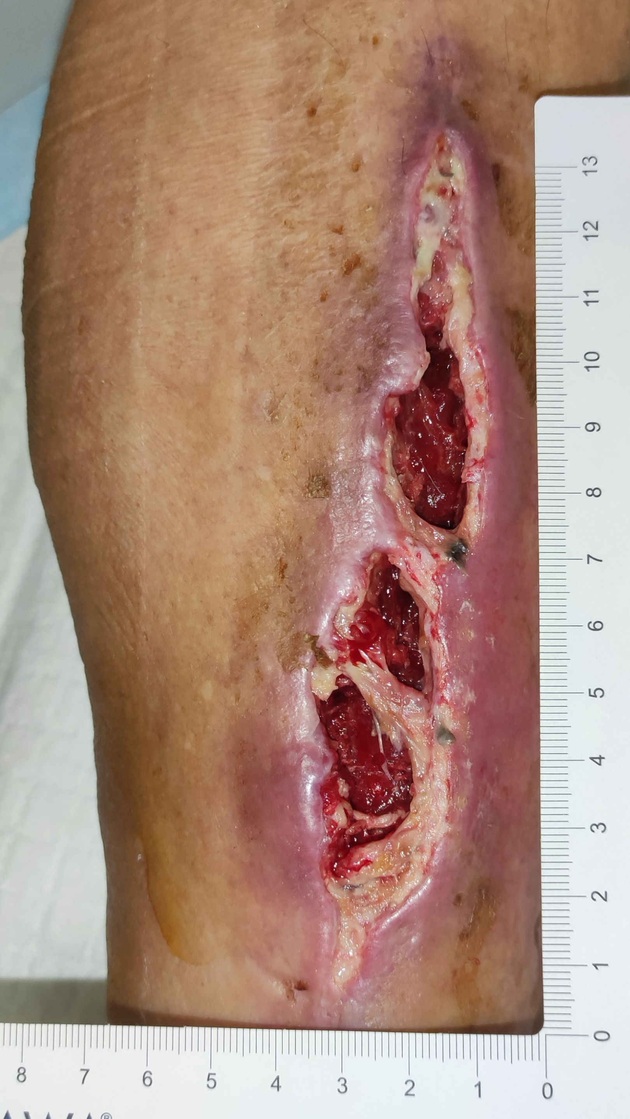
Healed in 42 days
Heald in 48 days
Dehicence in groin area after the revascularisation
Dehiscenece of the wound after the GSV harvesting for CABG
25.3.2024
12.3.2024
12.2.2024
24.1.2024

Slide 16
In conclusion
Sonication of the ceramic wound dressing CERDAK
It is more sensitive in capturing bacteria than a swab and achieves a sensitivity of up to 93.6% compared to a swab's sensitivity of 48% (p < 0.05).
It is also more sensitive in capturing resistant and multi-drug resistant bacteria than a swab (p < 0.05).
According to the method of sonication of the ceramic dressing, we were the first to rationally treat wounds with antibiotics with a healing success rate of almost 69.23% in the monitored period.
By combining the method of sonication of the ceramic dressing with local treatment of infected wounds using ceramic dressing, complete healing occurred in 18 out of 29 monitored wounds within the observed period, with an average healing time of up to 42 days (p < 0.05)

Slide 17
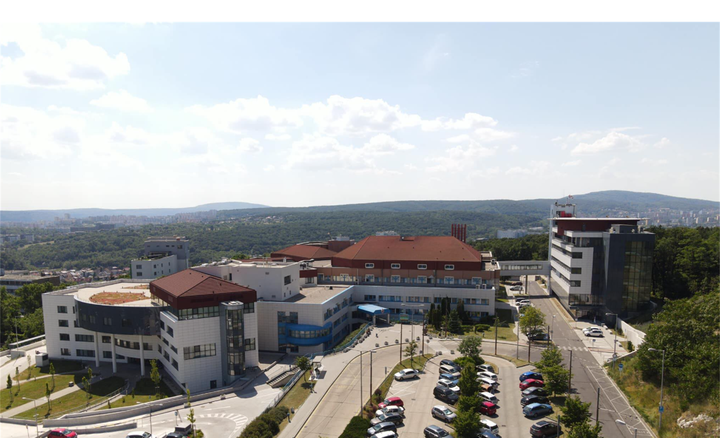

Thank you for your attention!
Safe travel home

